Slide 1
Lecture 3
File system & Essential Shell Commands
CoSc2043 – Network and System Administration

Slide 2
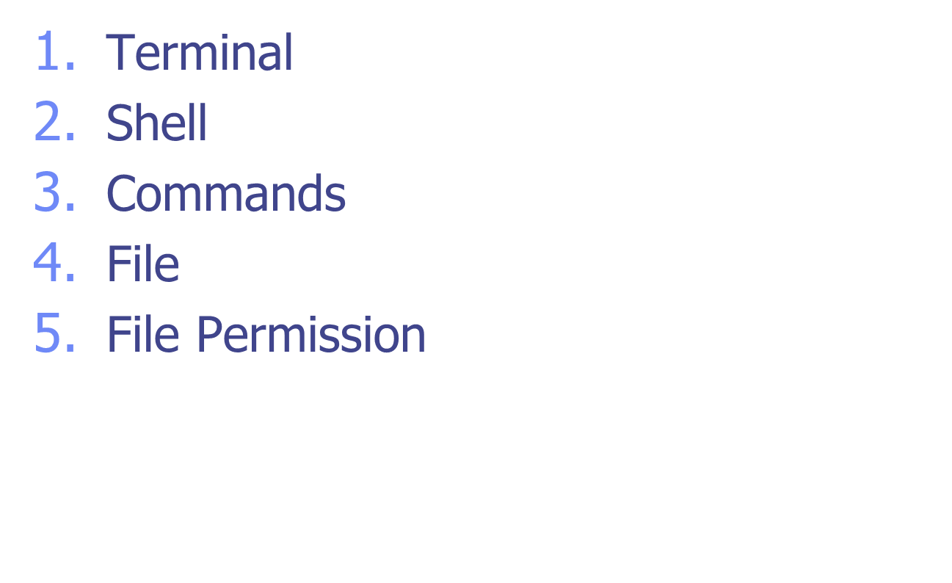
Topics

Slide 3
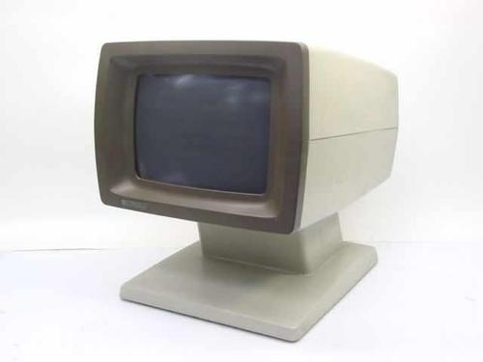
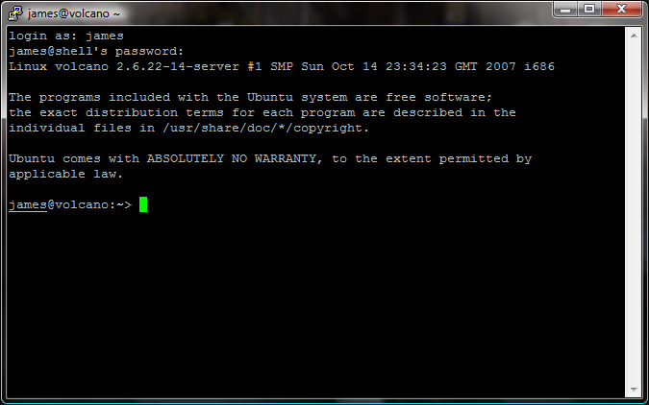
A Quick Start
Terminal
PuTTy, a telnet/ssh client
  a free and open source terminal emulator application
    a window in your desktop that works like old time terminal
Enter your ID and password

Slide 4
Your first encounter: shell
Shell: a special-purpose program, command line interpreter, read commands typed by a user and execute programs in response to entered commands
Many different shells:
  Bourne Shell (sh): oldest,
    I/O redirection, pipelines, filename generation (globbing), variables, environment variables, command substitution, background command execution, function
  C Shell (csh): syntax of flow-control similar to C, command history, command-line editing, job control, aliases
  Korn Shell (ksh): “csh”, compatible with sh
  Bourne again Shell (bash): GNU’s reimplementation of Bourne shell, supports features added in C shell, and Korn shell

Slide 5
Check/Change Login Shell
To check the shell you are using
  echo $SHELL
  echo $0
login shell: default shell for a user, specified in /etc/passwd
To change your login shell, use command
  chsh

Slide 6
Shell: interactive mode
A shell session (a dialog between user and shell)
  Displays a prompt character, and waits for user to type in a command line
    Prompt depends on shell: sh, ksh, bash: $ csh: % tcsh: >
    May be customized (with current directory, host, ...)
  On input of a command line, shell extracts command name and arguments, searches for the program, and runs it.
  When program finishes, shell continues to step 1
  The loop continues until user types “exit” or “ctrl-d” to end

Slide 7
UNIX command line
Command name and arguments:
command [ [ - ] option (s) ] [ option argument (s) ] [ command argument (s) ]
  Command arguments are mostly file or directory names
    cp prog1.cpp prog1.cpp.bak
  Options: used to control behavior of the command
    head -20 lab1.cpp
    wc –w lab2.cpp // count how many words
    Some options come with option argument
      sort –k 1 data.txt
      // use the first column of data.txt as the key to sort

Slide 8
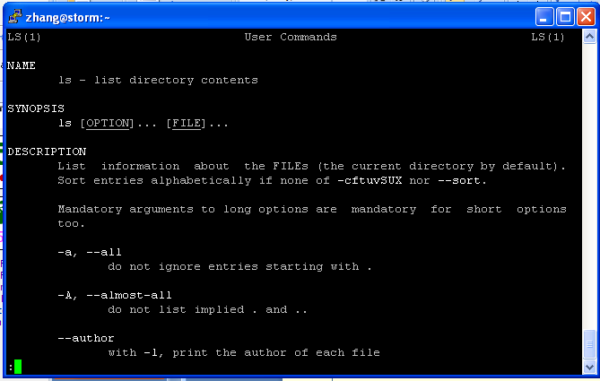
The most important command !!!
man: displaying online manuals
  Press q to quit, space to scroll down, arrow keys to roll up/down
man ls

Slide 9
Correcting type mistakes
Shell starts to parse command line only when Enter key is pressed
Delete the whole line (line-kill): C-u
Erase a character: C-h or backspace key
Many more fancy functionalities:
  Auto-completion: press Tab key to ask shell to auto-complete command, or path name
  History (repeat command): use arrow (up and down) keys to navigate past commands
  …

Slide 10
Shell: batch/scripting mode
In batch mode, shell can interpret and execute shell scripts
  #!/bin/bash
  # count number of files/directories in curr. directory
  ls –l | wc –l
Shell constructs:
  variables,
  Loop and conditional statements
  I/O commands (read from keyboard, write to terminal)
  Function, arrays …

Slide 11
Unix File
Files: store information
  a sequence of 0 or more bytes containing arbitrary information
What's in a filename?
  Case matters, no longer limited to 14 chars
  Special characters such as -, spaces are allowed, but you shouldn’t use them in filename
    Can you think of the reason ?
  Dot files are hidden, i.e., normally not listed by command ls
    To display all files, including hidden files, use ls -a

Slide 12
What’s in a file ?
So far, we learnt that files are organized in a hierarchical directory structure
  Each file has a name, resides under a directory, is associated with some admin info (permission, owner)
Contents of file:
  Text (ASCII) file (such as your C/C++ source code)
  Executable file (commands)
  A link to other files, …
  Virtual file:
    /proc: a pseudo-filesystem, contains user-accessible objects on runtime state of kernel and executing processes
To check the type of file: “file <filename>”

Slide 13
File Viewing Commands
cat: concatenate files and display on standard output (i.e., the terminal window)
  cat [option] … [file] …
  cat proj1.cpp
  cat proj1.cpp proj2.cpp
  cat –n proj1.cpp // display the file with line #
More: file perusal filter (i.e., displaying file one screen at a time)
  more proj1.cpp
head, tail: display the beginning or ending lines of a file
  tail -f output // display the file, append more lines as the file grows
[ ] means the argument is optional
… means there can be multiple
arguments of this type

Slide 14
File manipulation commands
rm: remove one or multiple files or directories
  rm [option] … FILE …
  rm temp
  rm temp1 temp2
Wildcards (metacharacter) can be used in command line
  Letter * matches with any string
    rm *.o: remove all .o files
  ?: match any one character
  [abc]: match with letter a or b or c
rm –r: remove directories and their sub-dirs recursively
rm –i : confirm with user before removing files

Slide 15
File manipulation commands (2)
cp: copy file or directory
  cp [OPTION] SOURCE DESTINATION
To make a backup copy of your program before dramatic change
  cp proj1.cpp proj1.cpp.bak
To make a backup copy of a whole directory
  cp –r lab1_dir lab1_dir_backup
  -R, -r, --recursive: copy directories recursively

Slide 16
File manipulation commands (3)
mv: move (rename) files/directories
  mv [OPTION] SOURCE DEST
    Rename SOURCE to DEST
    mv proj1.cpp lab1.cpp
  mv [OPTION]… SOURCE… DIRECTORY
    Move SOURCE to DIRECTORY
    mv lab1.cpp lab2.cpp CISC3130

Slide 17
Hierarchical file system
Directory: a file that can hold other files
Advantages of hierarchical file system:
  Files can have same names, as long as they are under different directories
  Easier for protection
  Organized files
/ (root)
dev
bin
home
etc
lib
cdrom
tty24
group
passwd
staff
zhang

Slide 18
Absolute pathname, path
/ (root)
dev
bin
home
etc
lib
cdrom
tty24
passwd
staff
zhang
Pathname of a file/directory: location of file/directory in the file system
  How do you tell other where your prog. Is located ?
Absolute pathname: path name specified relative to root, i.e., starting with the root (/)
  e.g., /home/staff/zhang
  What’s the absolute pathname for the “passwd” file?

Slide 19
Home directory
Every user has a home directory created for him/her
  When you log in, you are in your home directory
  In home directory, a user usually has permission to create files/directories, remove files ..
  ~ to refer to current user’s home directory
  ~username to refer to username’s home directory

Slide 20
Current directory & Relative Pathname
Tiring to specify absolute pathname each time
To make life easier: working directory
  User can move around the file system, shell remembers where the user is (i.e., current directory)
To check your current directory, use command:
  pwd

Slide 21
Getting around in the file system
To create a subdirectory:
  mkdir [option]… directory…
  cd
  mkdir CISC3130
  cd CISC3130
  mkdir lab1
To remove a directory:
  rmdir [option]… directory…
  Report failure if directory is not empty
    Can use rm –rf to remove non-empty directory

Slide 22
Command for change current directory (move around)
  cd [directory]
  [zhang@storm Work]$ cd
  [zhang@storm ~]$ pwd
  /home/staff/zhang
  [zhang@storm ~]$ cd Work
  [zhang@storm Work]$ pwd
  /home/staff/zhang/Work
  [zhang@storm Work]$ cd ..
  [zhang@storm ~]$ pwd
  /home/staff/zhang
  [zhang@storm ~]$

Slide 23
Relative pathname
Absolute pathname: specified relative to root
Relative pathname: specified relative to current directory
  (current directory), .. (parent directory, one level up)
  If current directory is at /home/staff/zhang, what is the relative pathname of the file passwd?
    ../../../etc/passwd: go one level up, go one level up, go one level up, go to etc, passwd is there
/ (root)
dev
bin
home
etc
lib
cdrom
tty24
passwd
staff
zhang

Slide 24
Relative pathname
For all commands that take file/directory name as arguments, you can use pathnames of the file/directory
Example:
  cd /home/staff/zhang/public_html
  pico CISC3130/index.html
  cd .. (go up one level to parent directory)
  cp ../prog2.cpp prog2.cpp

Slide 25
Getting around in the file system
ls: list directory contents
  ls [OPTION] … [FILE]
  ls: list files/directories under current directory
  ls –l: long listing,
  [zhang@storm CISC1600]$ ls -l
  total 59180
  -rw-r--r-- 1 zhang staff 509952 Sep 7 13:02 3_types.ppt
  -rw-r--r-- 1 zhang staff 593408 Sep 14 23:38 4_computation.ppt
  -rw-r--r-- 1 zhang staff 1297 Sep 2 12:18 account.html
  -rw-r--r-- 1 zhang staff 3304448 Nov 7 18:24 ArrayVector1.ppt
  drwxr-xr-x 2 zhang staff 4096 Dec 8 22:36 Codes

Slide 26
Long listing
To get more information about each file
  [zhang@storm Demo]$ ls -al
  total 32
  drwxr-xr-x 5 zhang staff 4096 2008-01-16 16:01 .
  drwxr-xr-x 41 zhang staff 4096 2008-01-16 16:01 ..
  drwxr-xr-x 2 zhang staff 4096 2008-01-16 15:55 CCodes
  -rw-r--r-- 1 zhang staff 38 2008-01-16 16:01 .HiddenFile
  -rw-r--r-- 1 zhang staff 53 2008-01-16 15:57 README
  drwxr-xr-x 2 zhang staff 4096 2008-01-16 15:55 SampleCodes
drwxr-xr-x 4 zhang staff 4096 2008-01-16 15:56 ShellScriptes
Total disc space taken in blocks (1024 Byte)
User name of the owner and its group
d means
directory
Who has permission to read/write the file

Slide 27
Long listing explained
drwxr-xr-x 4 zhang staff 4096 2008-01-16 15:56 ShellScriptes
field 1
  1st Character: specifies the type of the file.
    - normal file, d directory, s socket file, l link file
  next 9 characters – File Permissions
field 2: specifies the number of links for that file
field 3 : specifies owner of the file
field 4: specifies the group of the file
field 5 : specifies the size of file.
field 6: date and time of last modification of the file
field 7: File name

Slide 28
File permissions
drwxr-xr-x 4 zhang staff 4096 2008-01-16 15:56 ShellScriptes
Each file is associated with permission info.
  Differentiate three type of users: owner user, users from same group as owner, others
  Three type of access: - in the field means no permission
    Read (r): use “cat” to open a file to read, use “ls” to list files/directories under a directory
    Write (w): modify the contents of the file, create/remove files from the directory
    Execute (x): execute the file, or “cd” or “search” the directory for file
Trying to list other’s directory
  [zhang@storm ~]$ ls ../roche/
  ls: cannot open directory ../roche/: Permission denied

Slide 29
User and Group
Each user has unique login name (user name), and corresponding numeric ID
  Group id, home directory, login shell:
  Stored in file /etc/passwd
Groups: each user can belong to multiple groups
  For collaboration …
  Group name, group id, user list info stored in /etc/group
Superuser
  ID: 0, username: root
  Bypass all permission checks …

Slide 30
More to play with
who: show who is logged on
  who am I
write: write to another user’s terminal (IMS?)
which: show the full path name of a command
  $ which bash
  /bin/bash
How does shell find a command ?
  Environment variable PATH stores a list of paths to search for programs: “set | grep PATH” or “echo $PATH”, “set” to show all variable settings
    PATH=$PATH:$HOME/bin:.
  Built-in commands: history, set, echo, etc.
mail: send email from command line
  mail –s “graded project” zhang < proj1.cpp

Slide 31
Summary
Unix, a time-sharing operating system
Operating system
  a program that sits between hardware and user
  Manages resources (CPU, memory, disk, network connection) and present user interface to user
Unix programming environment, i.e., platform
  the layered view

Slide 32
Summary (cont’d)
PuTTy emulates a terminal
Shell: a command line interface
  Engage in dialog (a session with user)
What’s in a command
  Name, and arguments
Hierarchical file system: file and directory
Commands for working with file system

Slide 33
References
Daniel P. Bovet and Marco Cesati, Understanding the Linux Kernel, 3rd edition, O’Reilly, 2005.
Robert Love, Linux Kernel Development, 2nd edition, Prentice-Hall, 2005.
Kwan Lowe, Kernel Rebuild Guide, http://www.digitalhermit.com/linux/Kernel-Build-HOWTO.html, 2004.
LWN, “Another Look at the New Development Model,” http://lwn.net/Articles/94605/, 2004.
Joseph Pranovitch, Wonderful World of Linux 2.2, http://kniggit.net/wwol22.html, 1999.
Joseph Pranovitch, Wonderful World of Linux 2.4, http://kniggit.net/wwol24.html, 2001.
Joseph Pranovitch, Wonderful World of Linux 2.6, http://kniggit.net/wwol24.html, 2003.
Claudia Rodriguez et al, The Linux Kernel Primer, Prentice-Hall, 2005.
Andrew S. Tanenbaum, Modern Operating Systems, 2nd edition, Prentice-Hall, 2001.
Linus Torvalds and David Diamond, Just For Fun: The Story of an Accidental Revolutionary, Collins, 2001.

